Slide 1
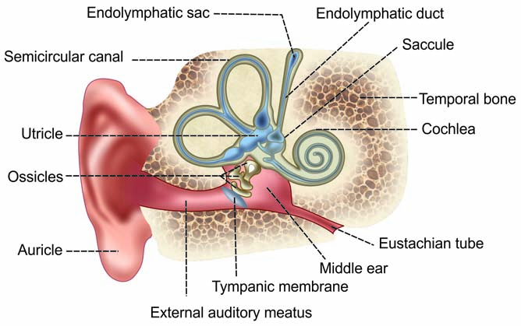
VESTIBULAR DISORDERS

Slide 2
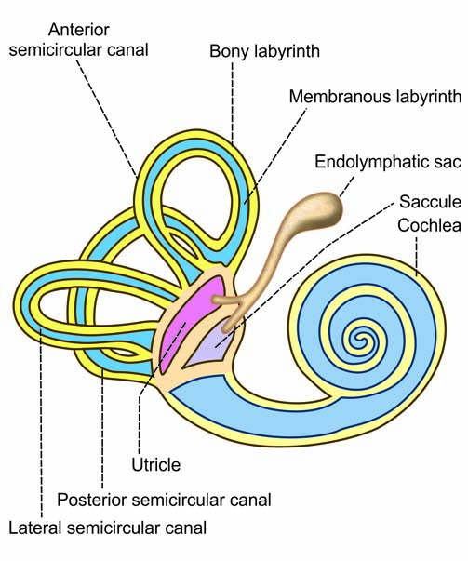
Labyrinth

Slide 3
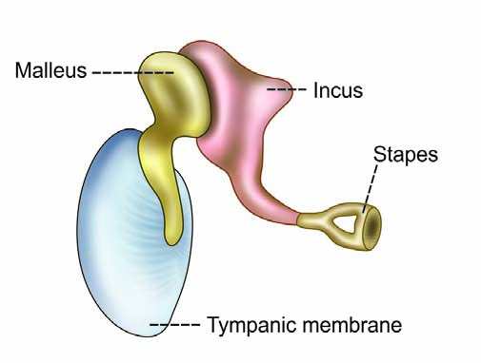
(stirrup)
Tympanic membrane and auditory ossicles

Slide 4
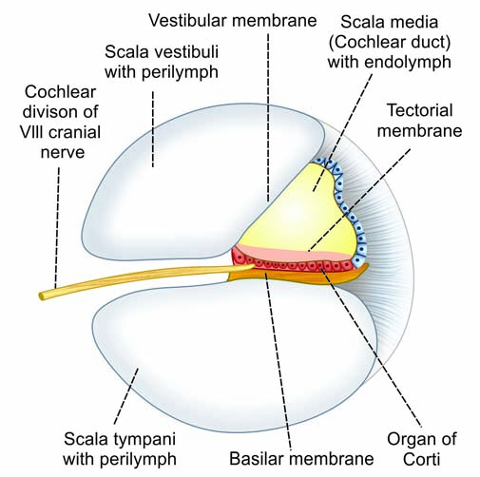
Cross­section of spiral canal of cochlea

Slide 5
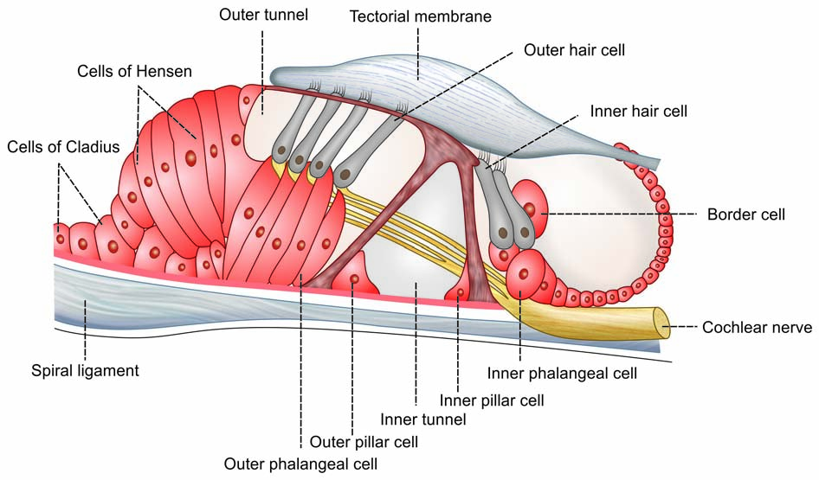
Organ of Corti

Slide 6
VESTIBULAR DISORDERS
Vestibular disorders typically present with vertigo
Majority of patients with an organic cause of vertigo will have labyrinthitis, benign paroxysmal positional vertigo or Ménière's disease.

Slide 7
Labyrinthitis
Also known as vestibular neuronitis
The most common cause of severe vertigo, but the cause is unknown.
It usually presents in the third or fourth decade as;
  severe vertigo, with vomiting but no tinnitus or deafness.
  It often starts on waking, and patients are usually bedbound by the vertigo for the first few days.
  The vertigo usually settles over 3-4 days, though head movement may continue to provoke transient symptoms (positional vertigo) for some time and it may take a month or so before the patient feels 'back to normal'.
  During the acute attack, nystagmus will be present but this typically disappears after a few days.

Slide 8
Symptomatic relief can be achieved with antihistamines such as cinnarizine, prochlorperazine, and betahistine.
These agents should not be used for long-term treatment of persistent vertigo as they are ineffective and actually delay recovery in many patients.
Patients with intractable symptoms may need referral to an ENT specialist for assessment, but input from an experienced vestibular physiotherapist is invaluable.

Slide 9
Benign paroxysmal positional vertigo
This is due to the presence of otolithic debris from the saccule or utricle affecting the free flow of endolymph in the semicircular canals (cupulolithiasis).
Assignment: State the meaning of the terminologies below
Hallpike man[oelig]uvre.
Epley man[oelig]uvre
Cawthorne-Cooksey exercises.

Slide 10
Ménière's disease
This is due to an abnormality of the endolymph which gives rise to paroxysms comprising a sensation of fullness in the ear followed by headache, tinnitus and profound vertigo, each attack typically lasting about 4 hours.
In between attacks, patients' hearing may be distorted (typically low-tone deafness).
While sensorineural hearing loss may be demonstrable, bedside examination is typically otherwise normal in between attacks, but audiometry is usually abnormal.
Management is as described for labyrinthitis.

